Slide 1
Introduction to Networking
Network Cabling

Slide 2
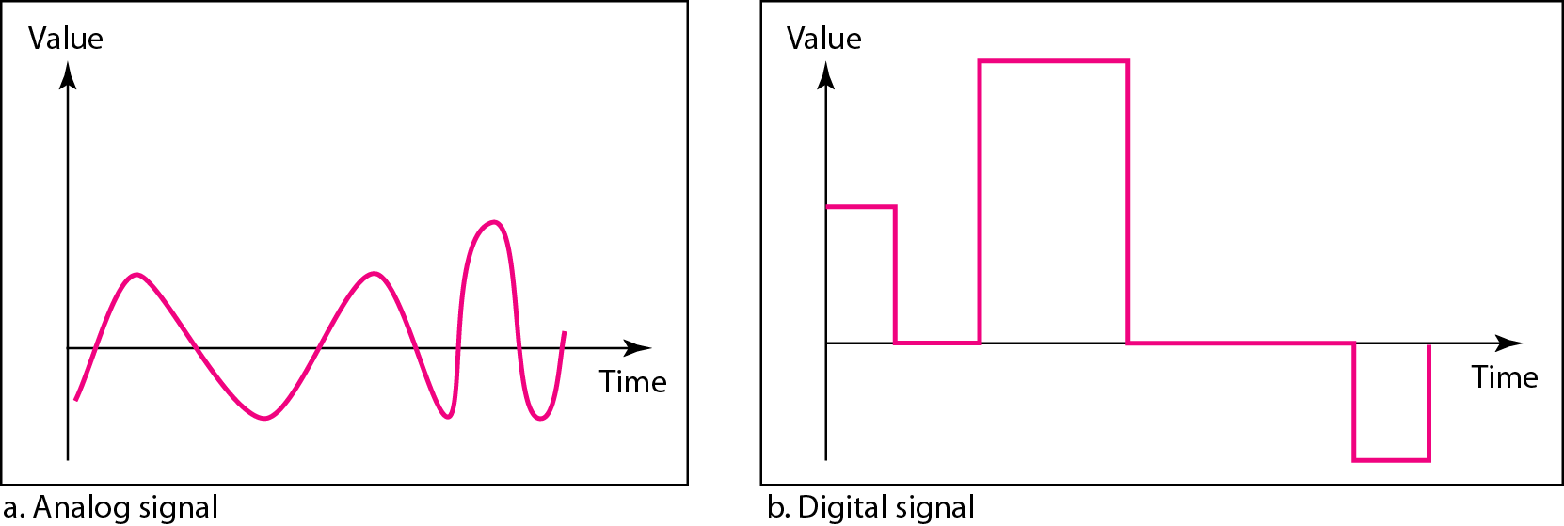
Broadband versus Baseband
Network cables are used to transmit different signal types at different speeds
A baseband cable transmits only one signal while a broadband cable can handle multiple signals
Baseband signals are normally found in LANs while broadband signals are generally found in WANs
Baseband signals are digital, while broadband signals are analog

Slide 3
Network Cables
Coaxial
Twisted Pair
  Unshielded (UTP)
  Shielded (STP)
Fibre
  Multimode Fibre (MMF)
  Singlemode Fibre (SMF)

Slide 4
Twisted Pair
Consists of two copper conductors, each covered with insulation.
The gauges of conductors used are typically 22 AWG (0.6438mm) or 24 AWG (0.5106mm).
The two wires are twisted so that each is equally exposed to interfering signals (noise)
  Differential (balance transmission)
    Information is conveyed by the difference in voltage potential between the two wires

Slide 5
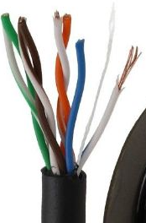
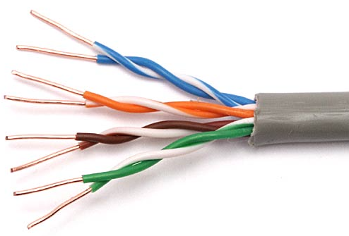
UTP

Slide 6
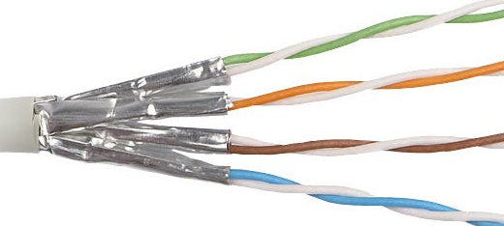
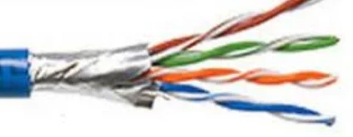
STP

Slide 7
Balanced / Differential Transmission
The signal voltage applied to one wire is V1 volts and the signal voltage applied to the other is the V2 volts, the signal being transmitted is V1 – V2.
This is referred to as a balanced signal.
If an externally induced noise voltage Vn is coupled to the wires, the twisting will cause Vn to be equally coupled onto both wires.
The voltage on one wire will be V1 + Vn, and the voltage on the other wire will be V2 + Vn.
The receiver will take the difference between the voltages, which is V1 + Vn – (V2 + Vn) = V1 – V2.
  The noise voltage has been subtracted out!

Slide 8
Cable Categories
Network cables are divided into categories based mainly on bandwidth (measured in MHz), maximum data rate (measured in megabits per second) and shielding.
  Cat 1 - two copper wires twisted around each other and was designed for analog voice communications
  Cat 2 - voice and data communications in 1980’snsupported a data transmission rate of 4 Mbps
  Cat 3 – 1990’s, 4 twisted pairs, 10 Mbps
  Cat 4 – like Cat 3 but up to 16 Mbps
  Cat 5 – 100 Mbps up to 100m
    Cat 5e – (unofficial) sub-Gigabit network installations, 1 Gbps, increased twists.

Slide 9
Cable Categories
Cat 6 – bandwidth and data transfer rates up to 1 Gbps over 100 m
  10 Gbps over shorter distances (37m), improved shielding and higher bandwidth (500MHz)
Cat 7 – Proprietary, not endorsed by IEEE or TIA
  Cat 7a 40 Gbps over 50m, 100 Gbps over 15m
Cat 8 – bandwidth of up to 2 GHz (2000 MHz) over 30 meters and a data rate of up to 40Gbs

Slide 10
Fibre
Consists of a core and a cladding
  Usually glass, can be plastic
    Glass for longer distances, plastic for shorter distances
  Core diameter – 8µm, 50µm, 62.5µm
  Cladding diameter – 125µm, 140µm
The core and cladding is covered in a plastic or silicone coating for protection (250 – 300µm)
Fibres are arranged in bundles in optical cables
  The cables consist of an outer protective jacket, inside this is a buffer tube, and the tube is filled with a gel filling to prevent water or moisture from damaging the fibres
  Kevlar reinforcing material is also used to protect the fibres

Slide 11
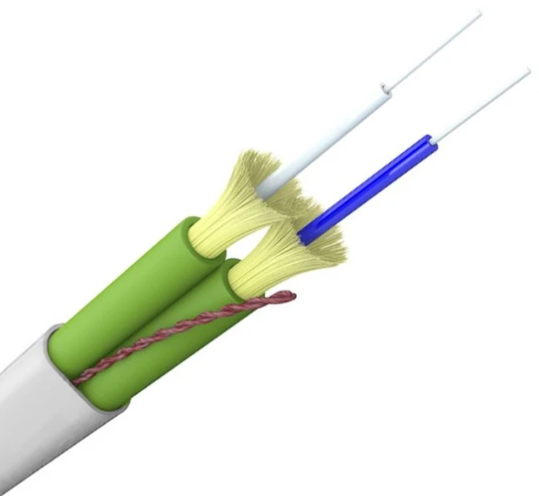
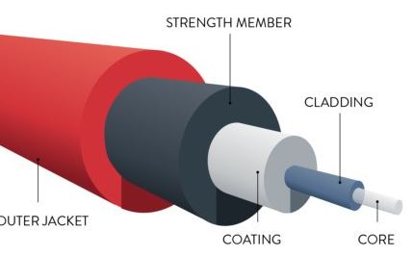
Fibre

Slide 12
Fibre Operation
The light guiding parts of the fibre are the core and the cladding
The index of refraction of the core is slightly higher than that of the cladding
Once light has been introduced into the core at an appropriate angle, the light will zig-zag down the fibre, bouncing off the boundary between the core and the cladding
This process is called total internal reflection

Slide 13
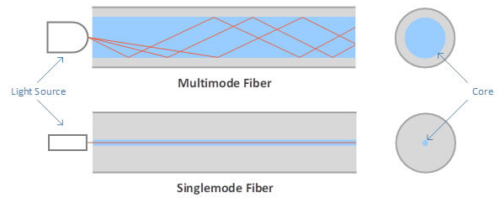
Fibre Operation

Slide 14
Structured Cabling
Flood wire a building
  Computers, Phone Systems, CCTV
Building or campus telecommunications cabling infrastructure
2 main area’s – horizontal and vertical cabling
Data cabling standards are governed by international regulations
  ISO 11801 (International Organisation for Standardisation)
  TIA-568 (Telecommunications Industry Association).

Slide 15
Not all Cables are made equal
Lots of vendors – cable difference can be substantial
All cables have to meet the ISO 11801 specification
But more expensive cable will usually well exceed the specification “head room”
  Cheaper will just meet the specification
Expensive cable can be more forgiving!

Slide 16
Horizontal Cabling
This is the cabling that runs from the desktops to the communications cabinet on the same floor
  2 cables are run to each desktop – computer & phone
At the desktop, the cable will be terminated in a telecommunications outlet, or faceplate
The other end of the cable will be terminated in a patch panel in the communications cabinet

Slide 17
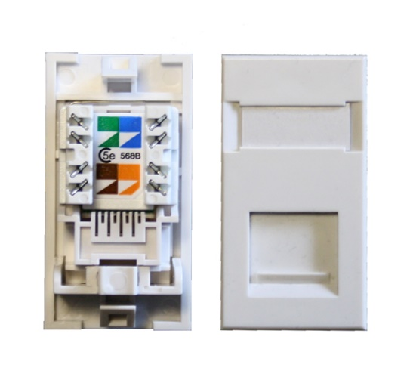
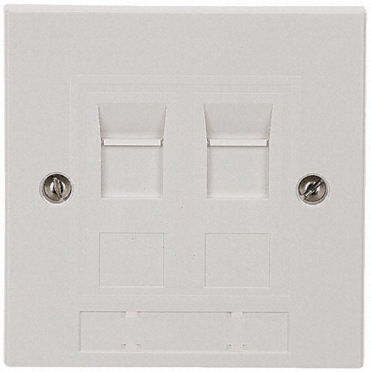
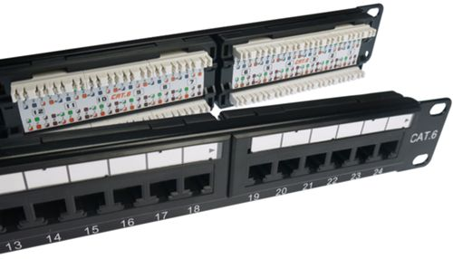
Diagrams
Telecommunications outlets
Faceplates
Patch Panel

Slide 18
Horizontal Copper Cable
Solid conductor UTP cable is used to connect the faceplates to the patch panels
  Not flexible but doesn’t need to be
  Installed behind walls and ceilings, it won’t be moved
  It is also cheaper
In general the maximum distance allowed between the data outlet and the patch panel should not exceed 90m.
Stranded cable is more flexible but it is also more expensive.
  The patch leads that are used to connect the desktop PC to the outlet are stranded as these cables tend to be moved and plugged in and out a lot
  In the comm’s cabinet a patch lead is also used to connect the patch panel to the switch.

Slide 19
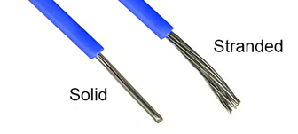
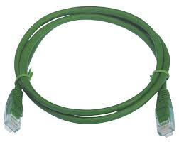
Diagrams
Solid & stranded UTP
Patch cable

Slide 20
Vertical Cabling
Is the data cabling that connects floors in a building
As a general rule all wall outlets/faceplates are cabled back to a cabinet on the same floor
Each floor would then have its own cabinet
These cabinets are linked together and this is called the vertical or backbone cabling.
While CAT6A can be used for the backbone cabling it is always good practice to use fibre in the backbone, where possible

Slide 21
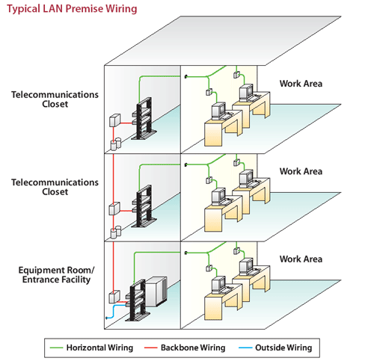
Diagram

